Slide 1
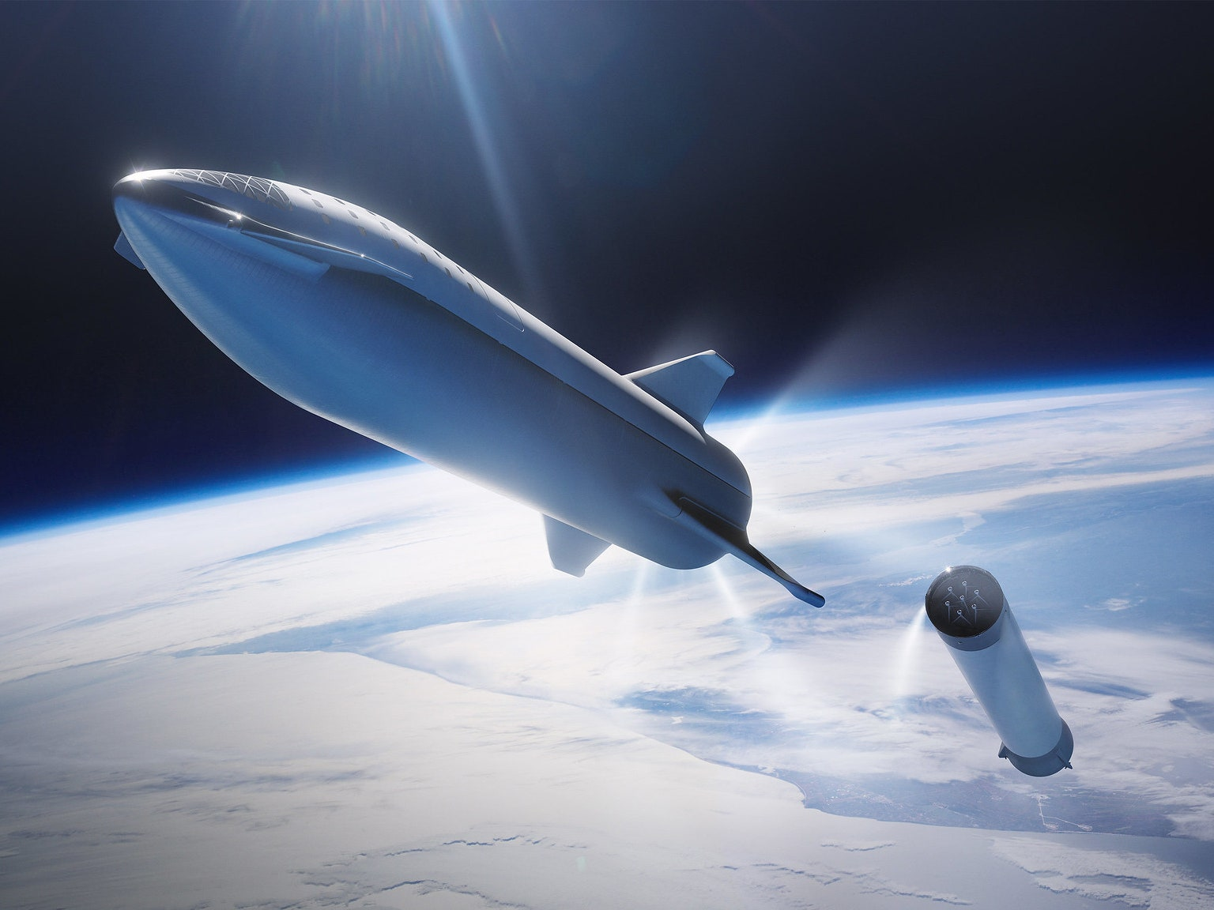






Decoding SpaceX's Launch Economics
Juan Camilo Pina
2023
Confidential report generated for Space Y by Juan Camilo Pina

Slide 2
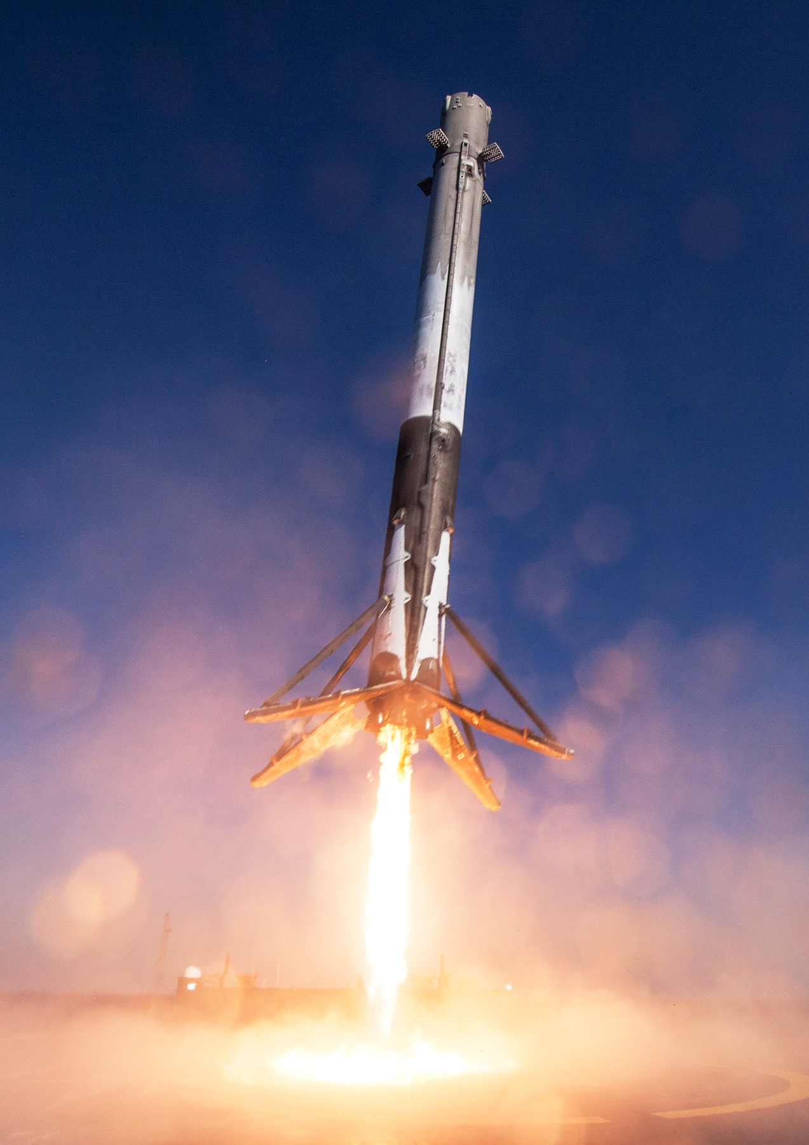
TABLE OF CONTENT
Introduction
Methodology
Results
Conclusion
Executive Summary

Slide 3






EXECUTIVE SUMMARY

Slide 4
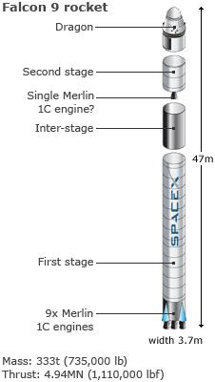
EXECUTIVE SUMMARY
Welcome to our project journey! In the era of accessible space travel, we delve into the economics of rocket launches, focusing on SpaceX, the industry leader. SpaceX's groundbreaking achievements, from ISS missions to Starlink, have reshaped space exploration. The key to their success lies in the cost efficiency of Falcon 9 launches—priced at $62 million compared to competitors' $165 million. The game-changer? Reusability.
Our mission as data scientists for Space Y, a SpaceX competitor, is to unravel the intricacies of launch pricing. Armed with data, we aim to create insightful dashboards for Space Y. The crux? Predicting the fate of Falcon 9's first stage with public information data—will it gracefully land for reuse, meet a controlled crash, or be sacrificed based on mission parameters? Buckle up as we explore the cosmos of data science to determine the future of rocket reusability and the cost implications for Space Y's ambitions.

Slide 5
INTRODUCTION

Slide 6
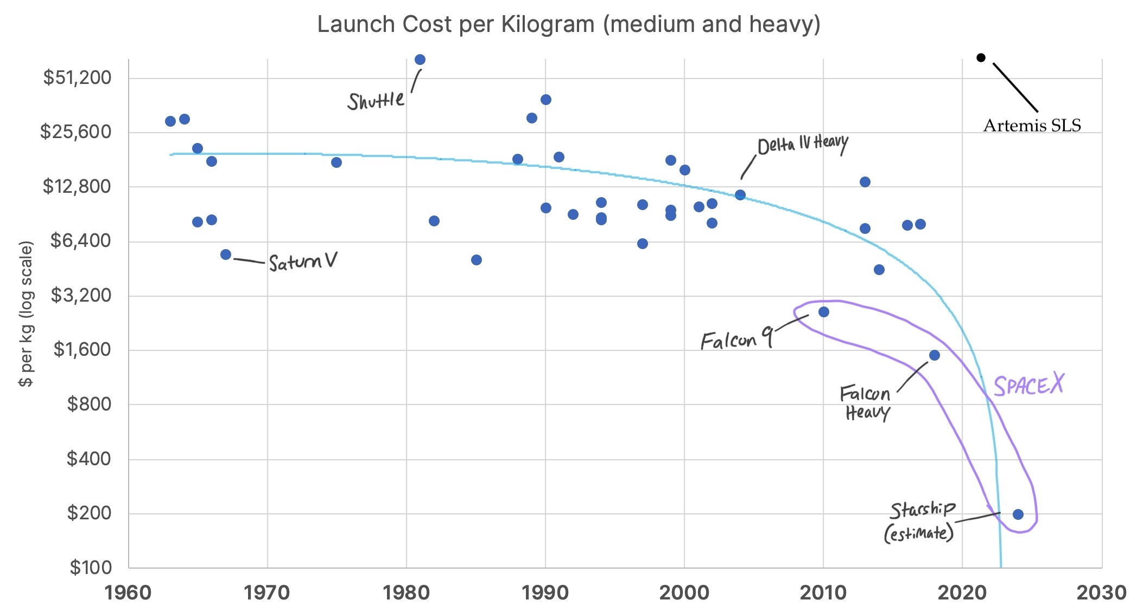
INTRODUCTION
Space X is the space travel industry leader
Key to their success lies in the cost efficiency of Falcon 9 launches
Falcon 9 launches cost $62M, while their competitors cost $165M. This is 38% of the competitor cost!
What allow Space X to be that cost-efficient is the reusability of their first phase of the project

Slide 7
INTRODUCTION
The payload is enclosed in the fairings
The second stage helps bring the payload to orbit
The first stage does most of the work and is much larger than the second stage
The fist stage is quite large and expensive
Unlike other rocket providers, SpaceX's Falcon 9 Can recover the first stage
Fairings

Slide 8


INTRODUCTION
Sometimes the first stage does not land. Sometimes it will crash
Space Y that would like to compete with SpaceX founded by Billionaire industrialist Allon Mask
This project objective is to determine the price of each launch
Price can be determined by calculating the probability of the Falcon 9 first stage reuse
This will be obtained by training a machine learning model using public information

Slide 9
METHODOLOGY

Slide 10
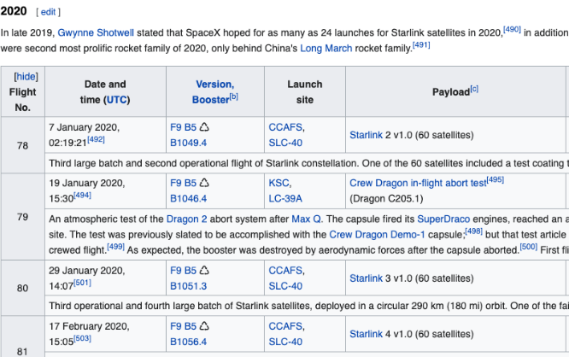
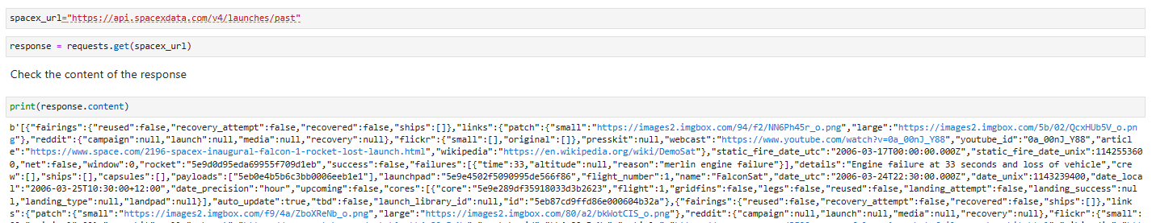
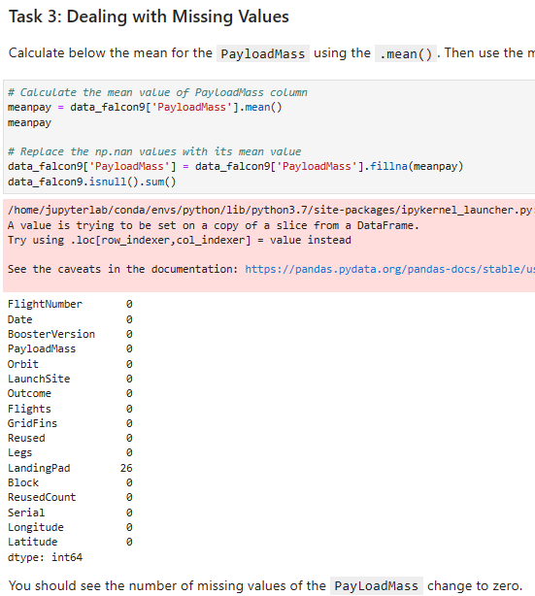
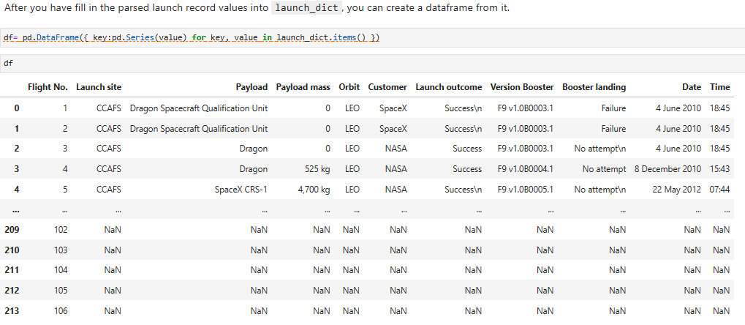
METHODOLOGY: Data Collection
Request data to the Space X API
Clean the requested data from Space X API
Web scraping from Wikipedia to collect historical launch records

Slide 11
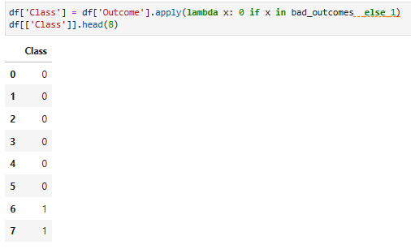
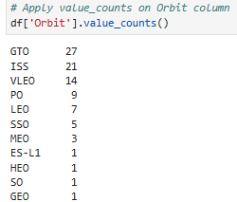
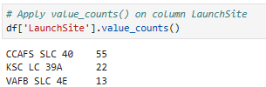
METHODOLOGY: Data Wrangling
Getting the Number of launches per site
Getting the number and occurrence per orbit
Creating a new column defining successfully landed (1) and unsuccessfully landed (0)

Slide 12
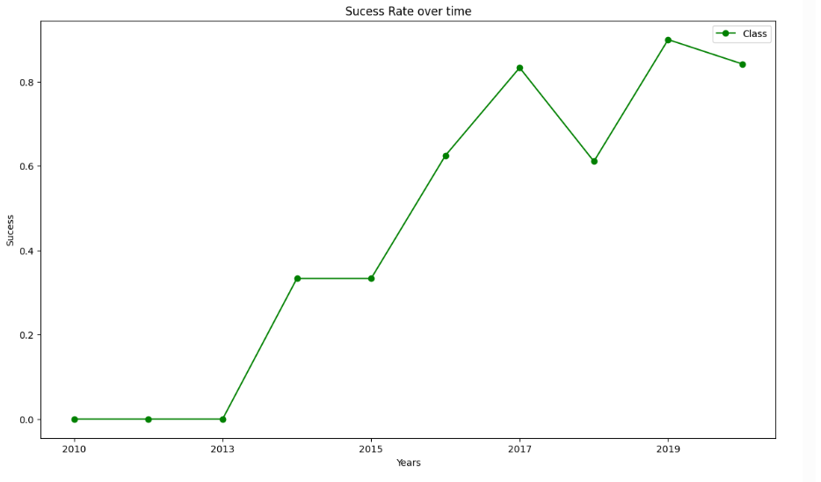
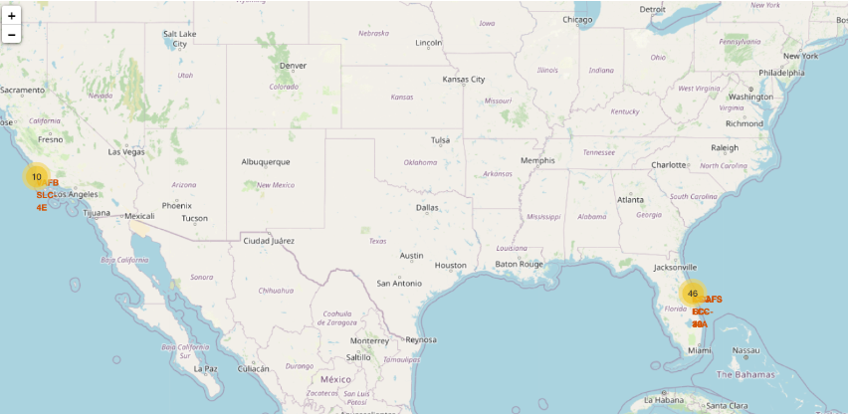
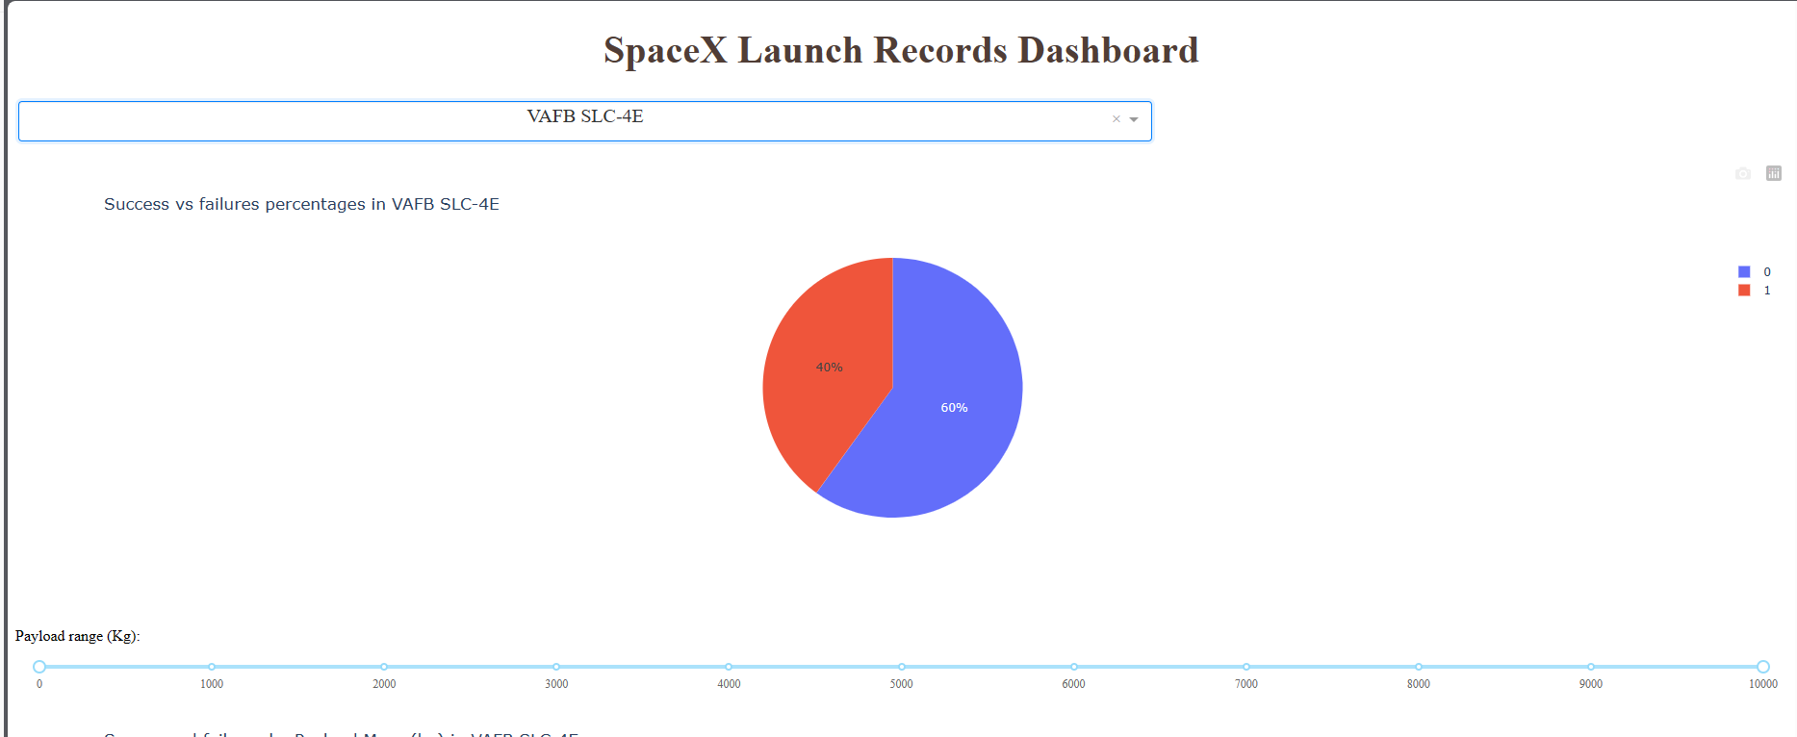
METHODOLOGY: Data Visualization and feature engineering
Different graphs were created to obtain preliminary insights about how each important variable would affect the success rate of the Falcon 9 rocket launch
Matplotlib and Seaborn for graphs
Interactive maps visualization using Folium
Dash with Plotly to create an interactive dashboard

Slide 13
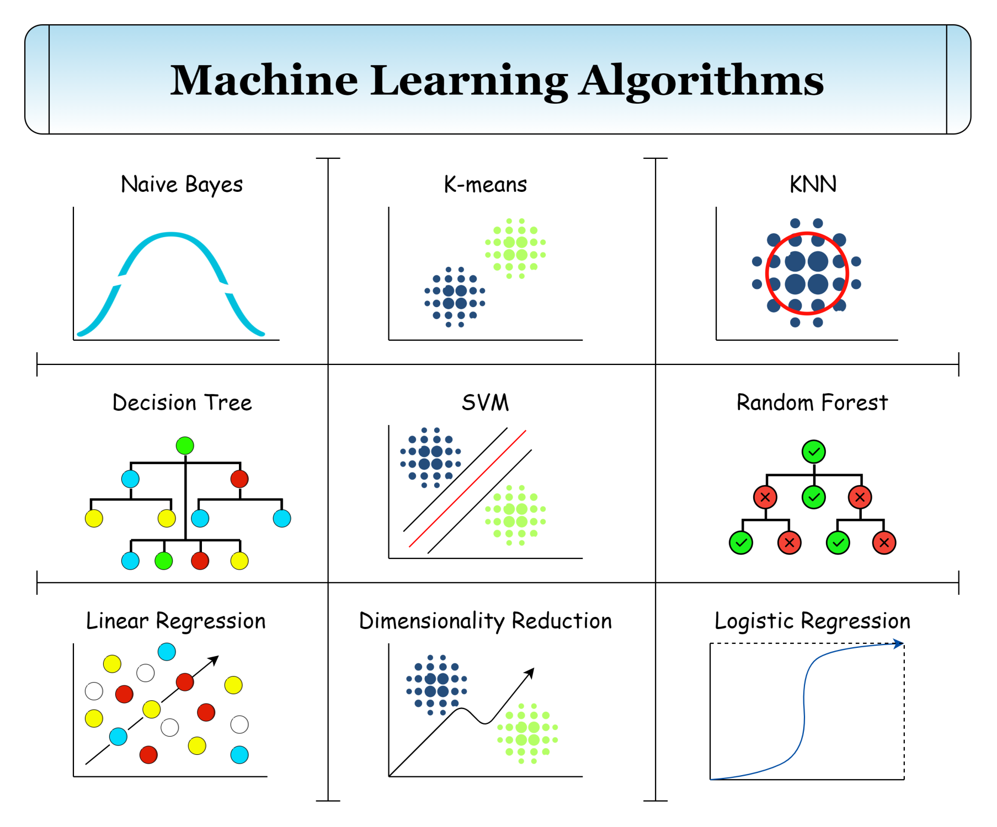
METHODOLOGY: Predictive Analysis
Preprocessing the data using the StandardScaler() function
Divided the data into training and test data using the train_test_split function
Using the Grid Search function for training diverse models
Logistic Regression
Support Vector Machine
Decision Tree
K-Nearest Neighbor
Find the model that performs the best

Slide 14
RESULTS

Slide 15
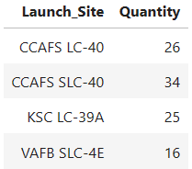
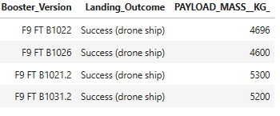
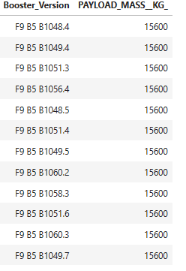
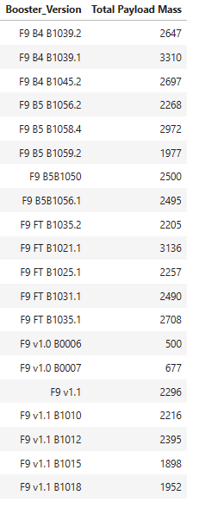
RESULTS – SQL
NASA Launches
Finding 1: There are 4 Launch Sites where all the companies launch their rockets. The CCAFS launch site is the place where most launches were made
Finding 2: Nasa payload mass is between 600 kg and 3.3 tons.
Finding 3: There are 4 booster versions with success drone ship outcome between 4 and 6 tons.
Finding 4: The maximum payload mass is 15.6 tons

Slide 16
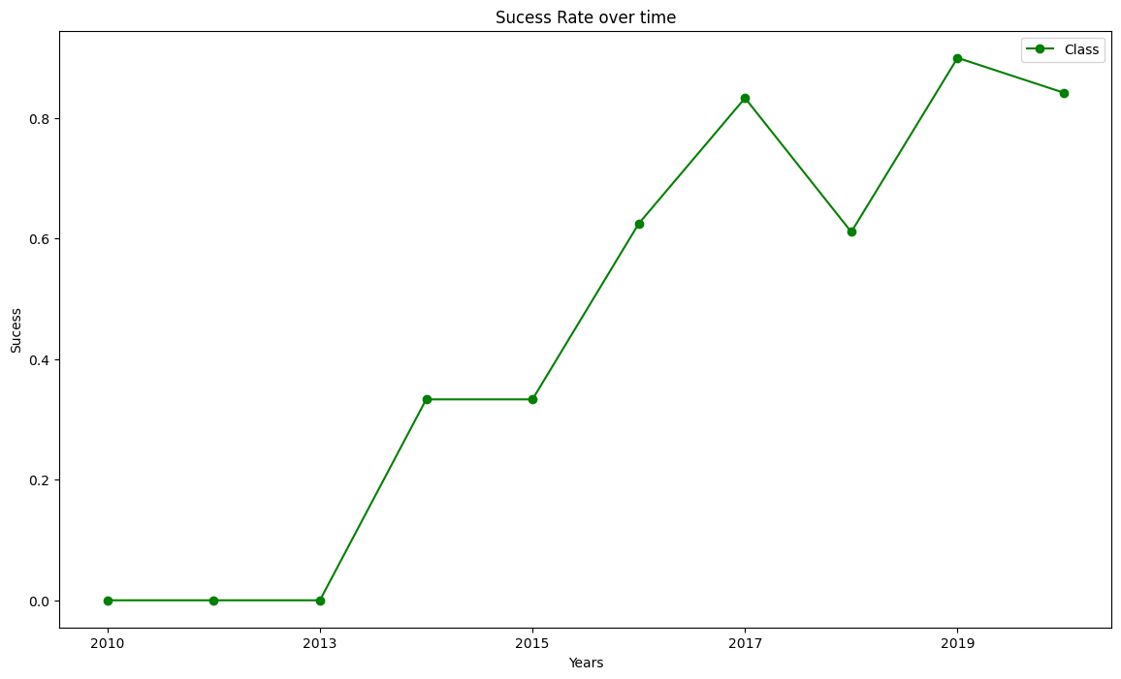
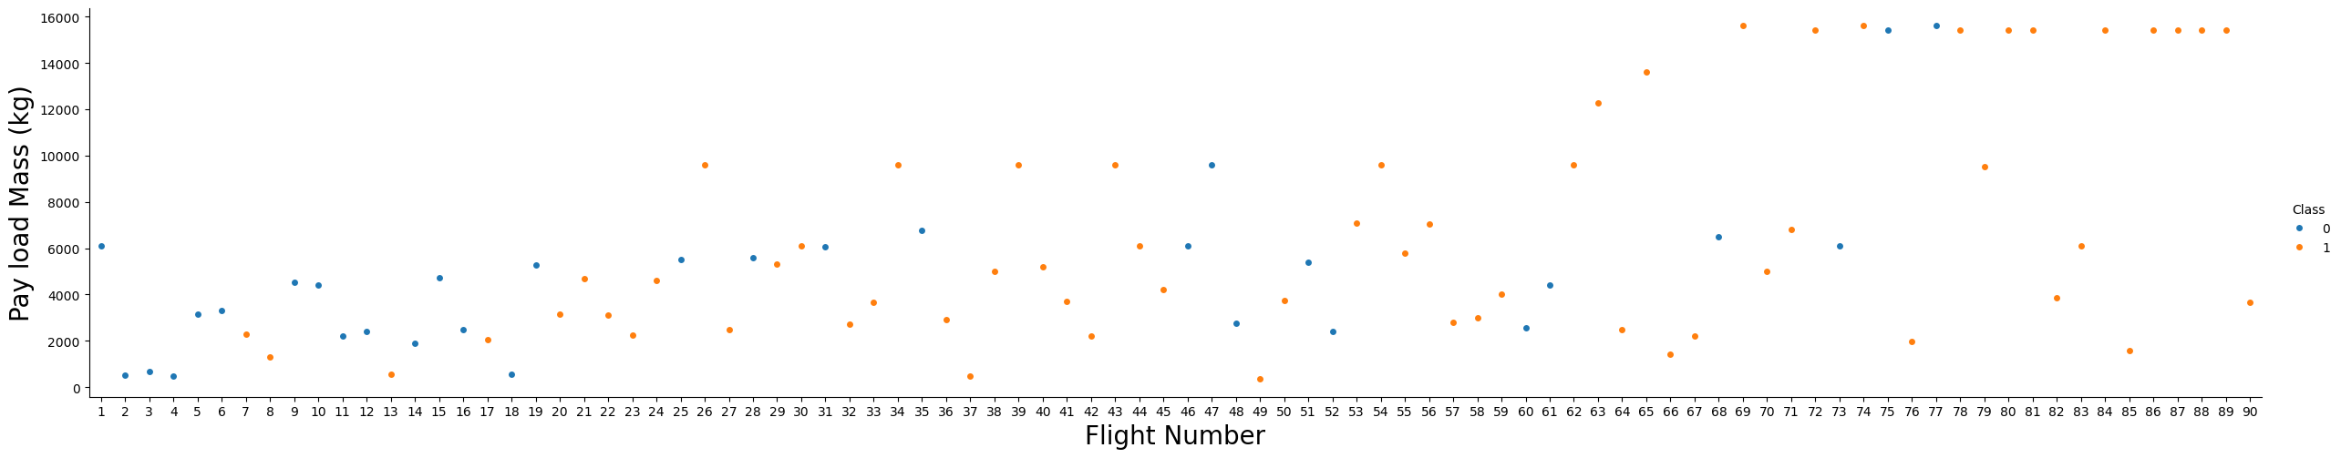
RESULTS – VISUALIZATION
Finding 5: As the flight number increases, the first stage is more likely to land successfully
Finding 6: The more massive the payload, the less likely the first stage will return

Slide 17
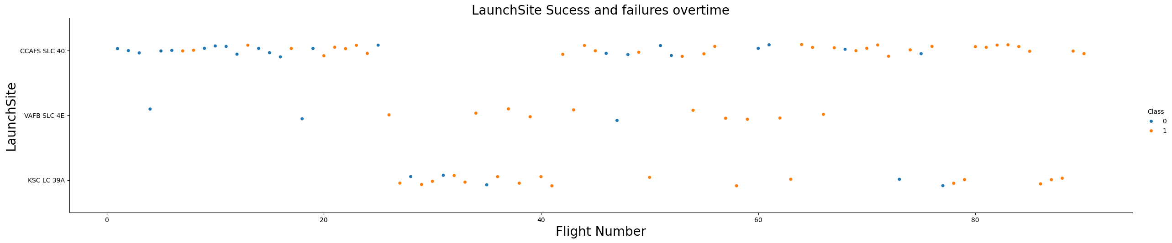
RESULTS – VISUALIZATION
Finding 7: Different launch sites have different success rates. CCAFS LC-40, has a success rate of 60 %, while KSC LC-39A and VAFB SLC 4E has a success rate of 77%
Finding 8: CCAFS LC-40 success rate was highly impacted by the first 20 missions, where the success rate was about 25%
Finding 9: Most of the Falcon 9 Launches are been done in the CCAFS LC-40 launch site

Slide 18
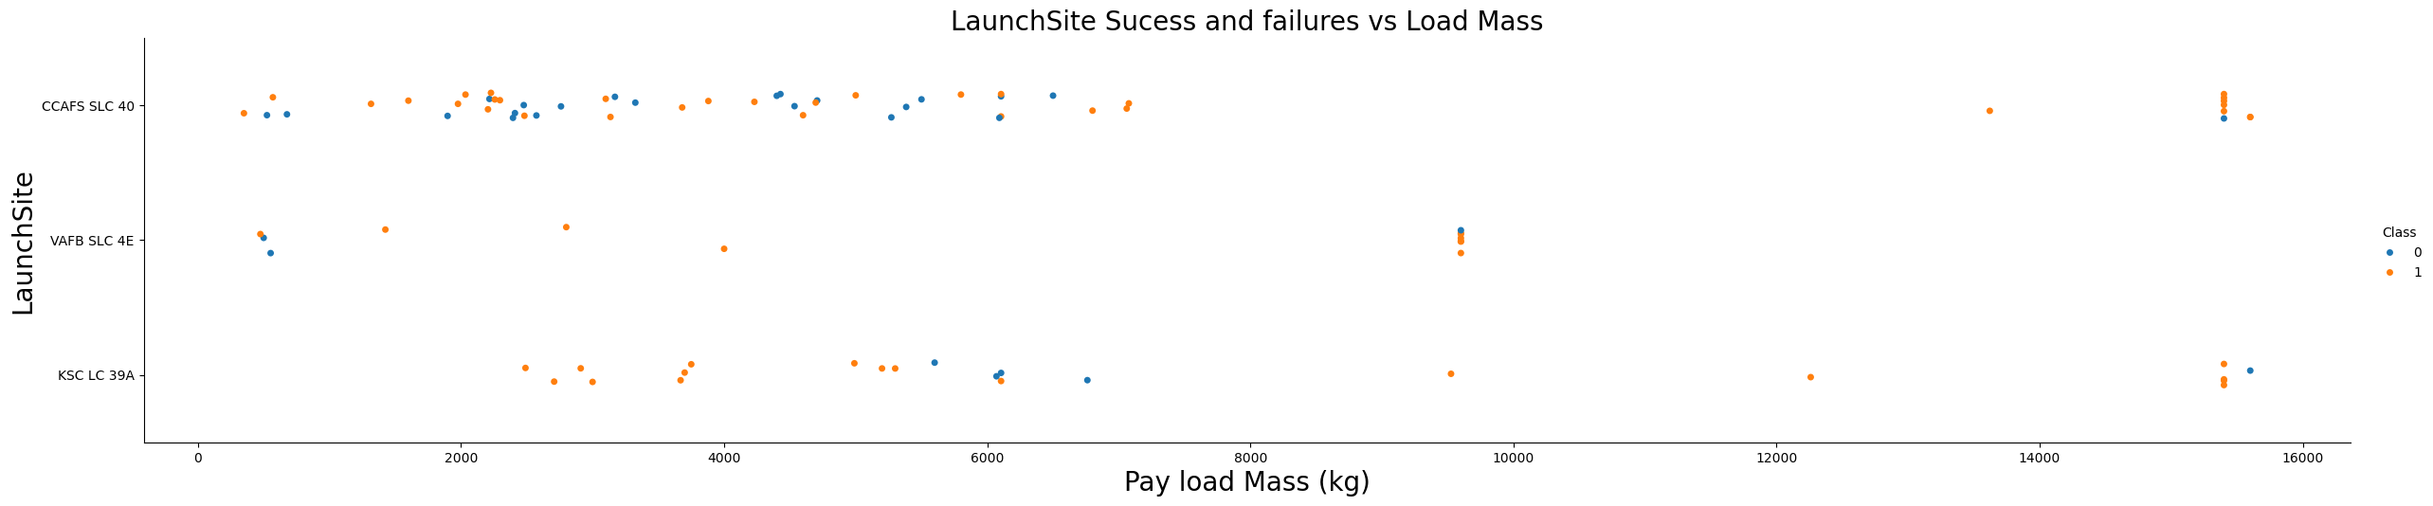
RESULTS – VISUALIZATION
Finding 10: There are not rockets launch for heavy payload mass greater than 10,000 kg for the VAFB-SLC launch site.

Slide 19
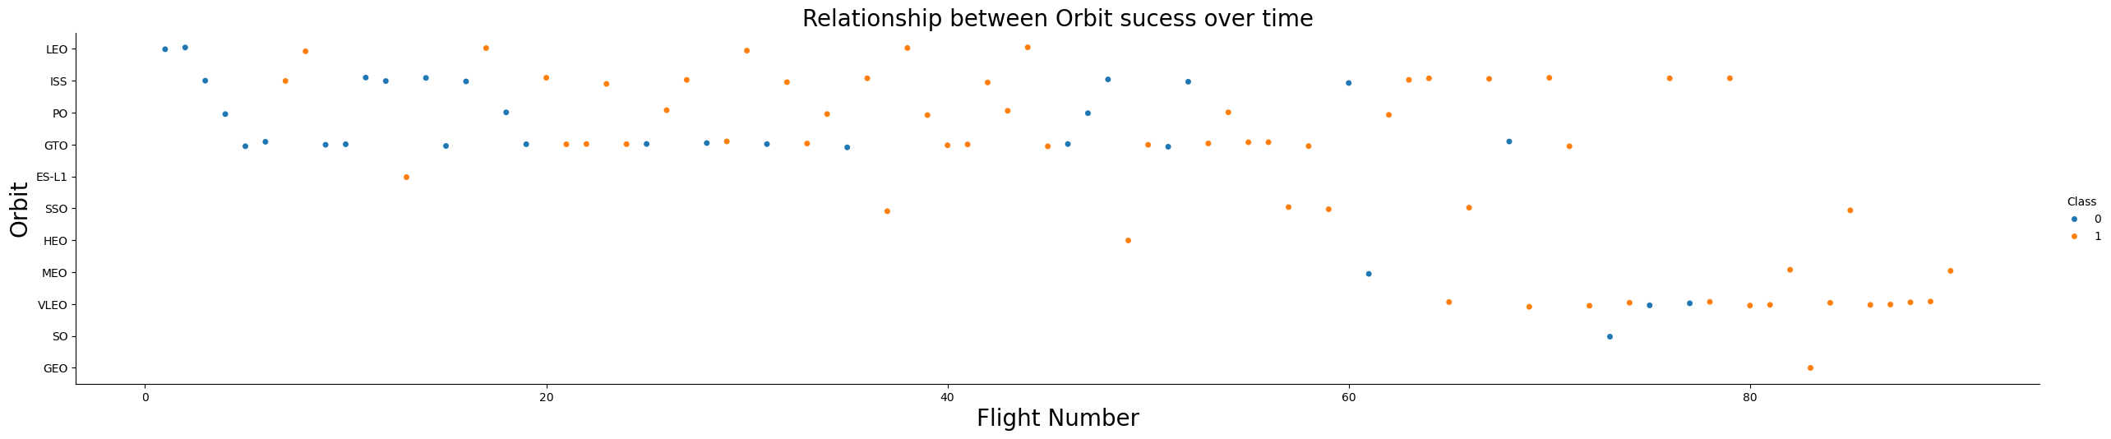
RESULTS – VISUALIZATION
Finding 11: LEO orbit the Success appears related to the number of flights; on the other hand, there seems to be no relationship between flight number when in GTO orbit

Slide 20
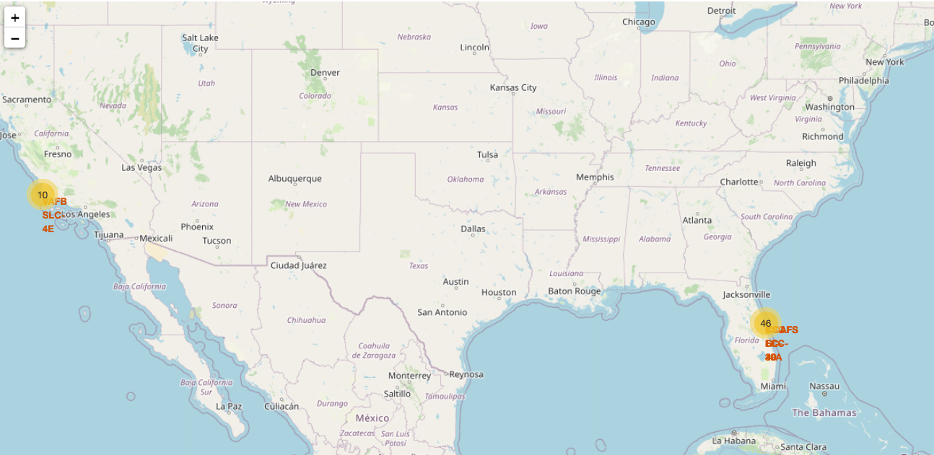
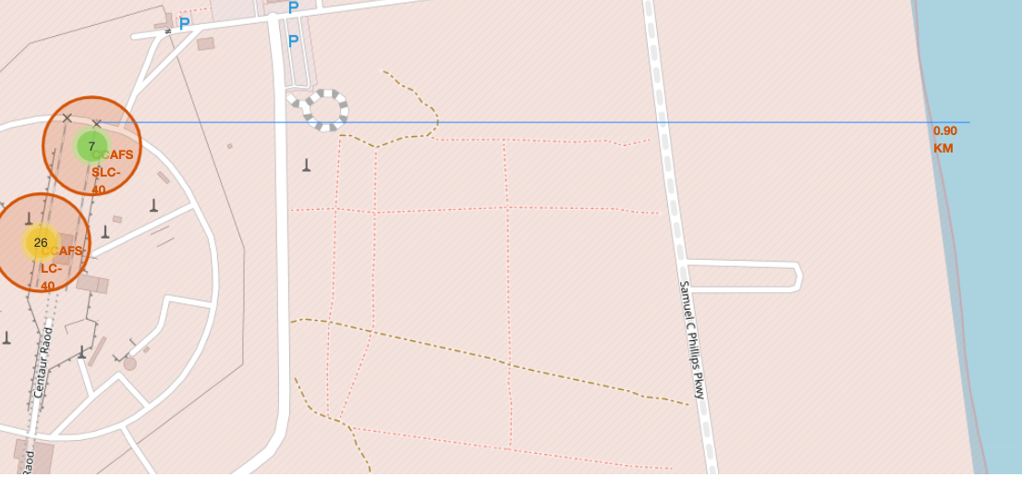
RESULTS – Interactive Map

Slide 21
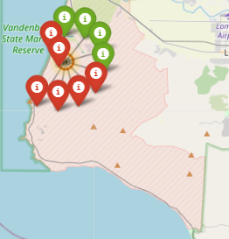
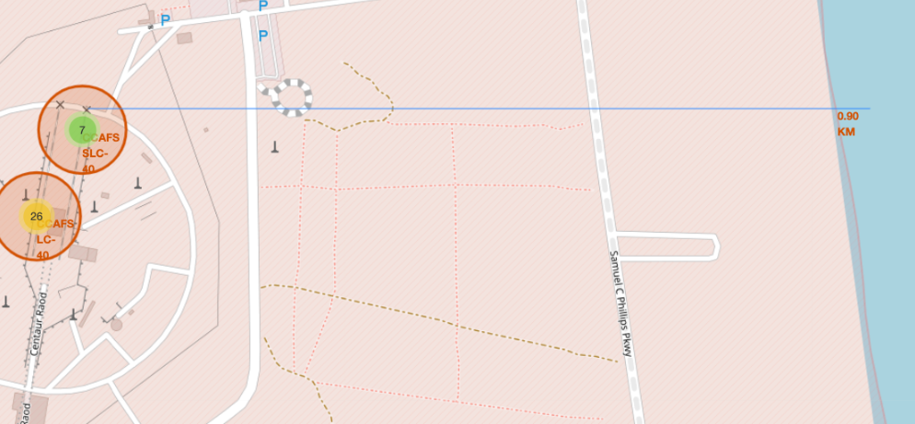
RESULTS – Interactive Dashboard
Finding 12: 82% of total Falcon 9 launches were in the East coast.
Finding 13: The East coast had a higher successful rate than the West coast launches
Finding 14: Launch sites are always located near the coast, rail roads and highways.

Slide 22
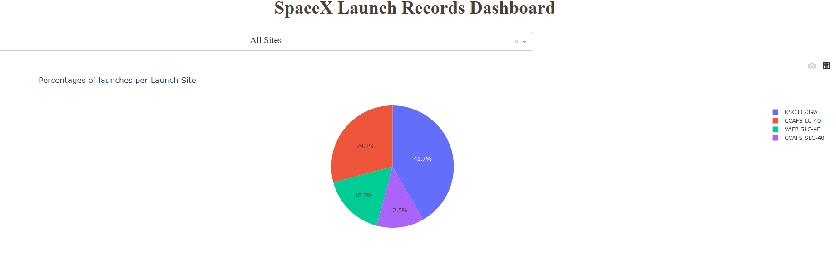
RESULTS – INTERACTIVE DASHBOARD
Click here to be redirected to the interactive dashboard
In case you can’t open the link, you can copy it and paste it in your browser: Dash (cognitiveclass.ai)

Slide 23
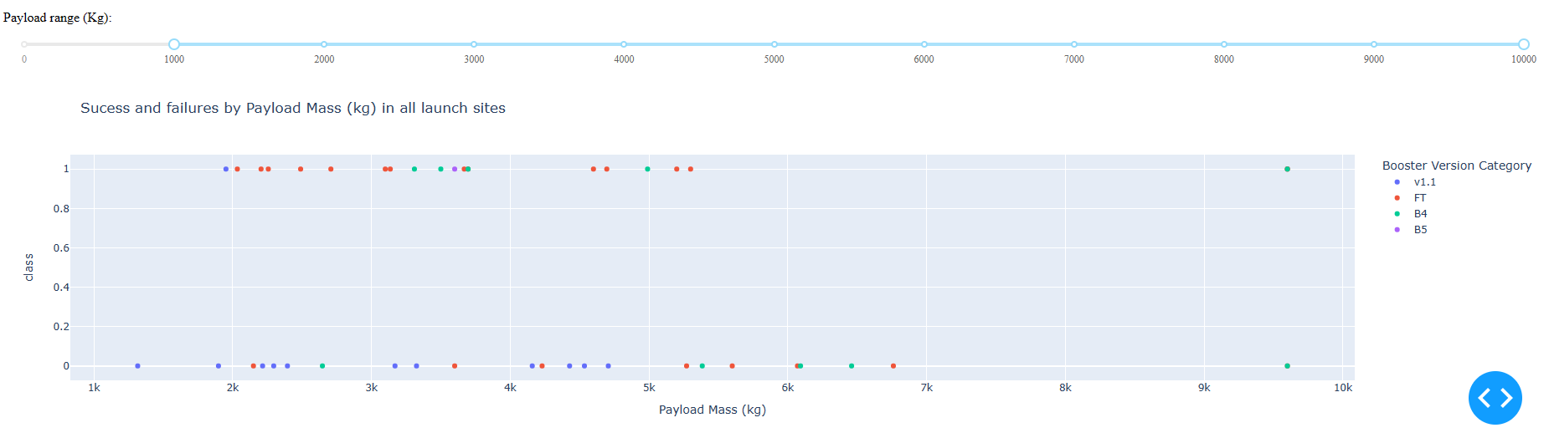
RESULTS - INTERACTIVE DASHBOARD – ALL SITES

Slide 24
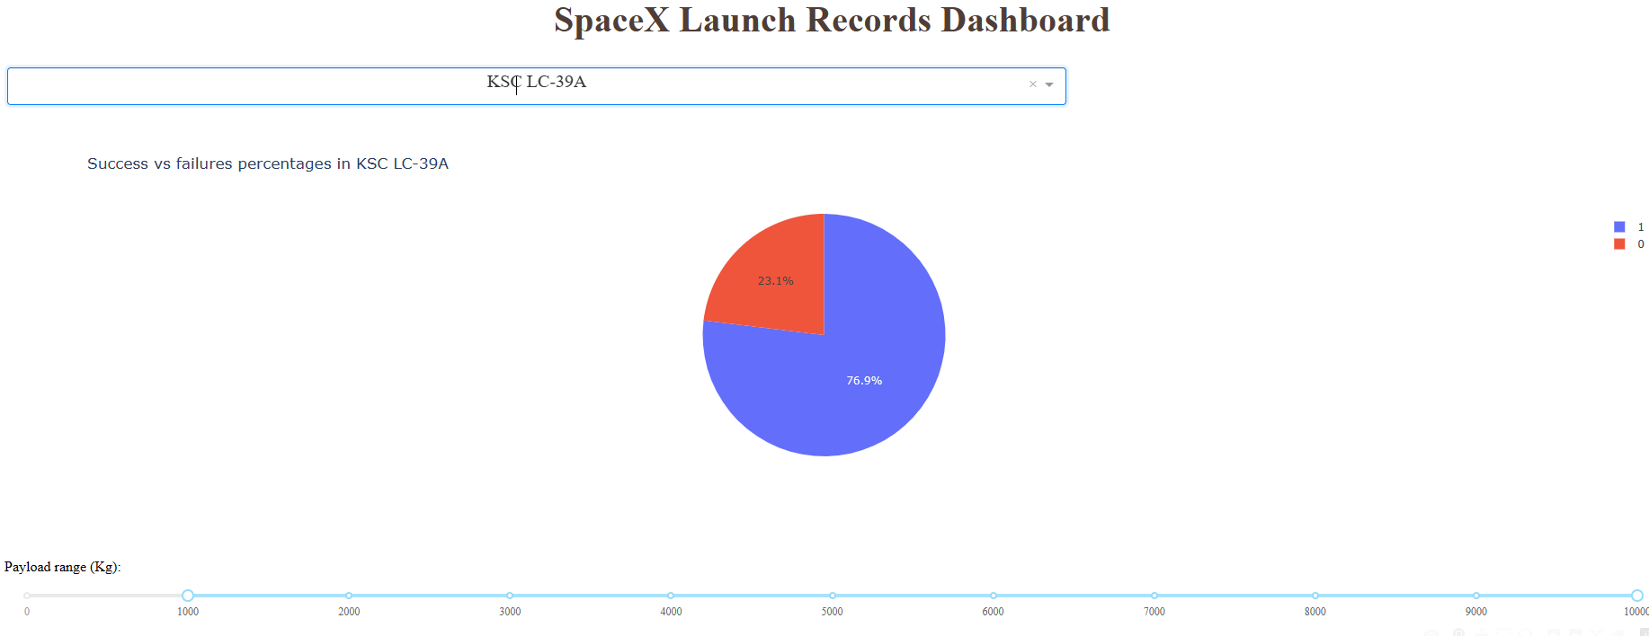
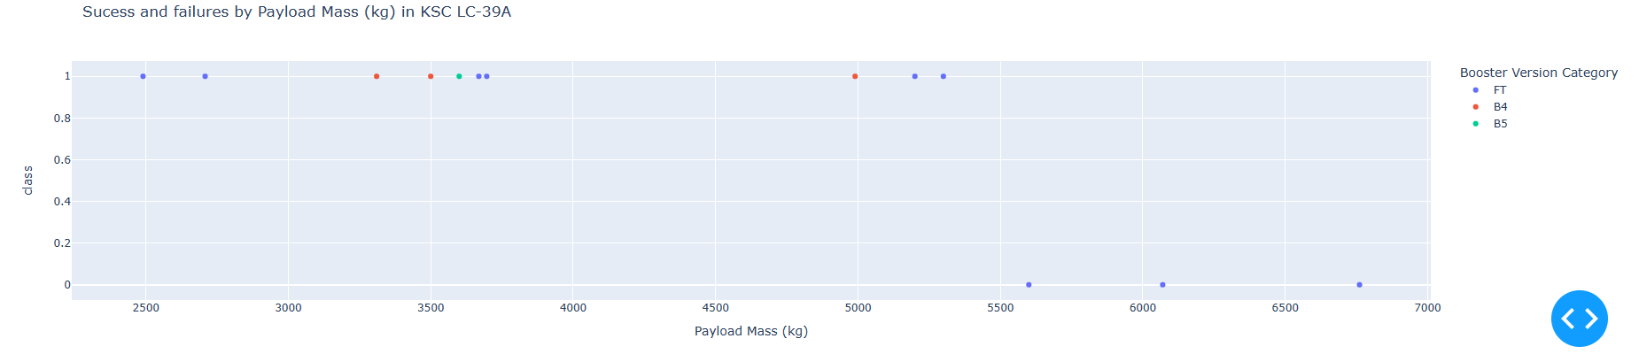
RESULTS - INTERACTIVE DASHBOARD – SPECIFIC LAUNCH SITES

Slide 25
RESULTS INTERACTIVE DASHBOARD
Finding 15: The Falcon 9 FT Booster version had the higher success among all Booster versions models
Finding 16: The launch success was lower when the payload range was less than 2,000 kg and from 6,000 kg to 10,000 kg.
Finding 17: The highest launch success was between payloads from 2,000 kg to 4,000 kg.

Slide 26

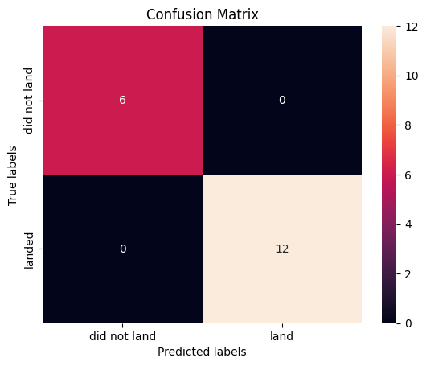
RESULTS – Predictive Analysis
Logistic Regression
C = 0.01
Penalty = 12
Solver = lbfgs
SVM
C = 1
Gamma= 0.03162
Kernel = sigmoid
Decision Tree
Criterion = gini
Max_depth = 16
Max_features = sqrt
Min sample leaf= 2
Min sample split =10
Splitter = best
KNN
Algorithm = auto
N_neighbors = 5
P= 1

Slide 27
RESULTS – Predictive Analysis
Model | Accuracy Score | Jaccard Index | F1 Score | LogLoss Score
KNN | 94% | 83% | 96% | NA
Decision Tree | 100% | 100% | 100% | NA
Logistic Regression | 94% | 83% | 96% | 36%
SVM | 94% | 83% | 96% | NA
Finding 18: Among the 4 models that were made to predict the Falcon 9 first stage outcome, the one with the best accuracy is the decision tree
Finding 19: The best parameters for the decision tree model are:
Criterion = gini
Max_depth = 16
Max_features = sqrt
Min sample leaf= 2
Min sample split =10
Splitter = best

Slide 28
CONCLUSION

Slide 29
CONCLUSION
Key Insights and Model Performance
In assessing the factors influencing the recovery of the Falcon 9 rocket's first stage, various variables were examined. The findings underscored the significance of the following key variables:
FlightNumber
PayloadMass
Orbit
LaunchSite
Flights
Among the four models evaluated, all demonstrated commendable accuracy. Notably, the decision tree model stood out with perfect predictions.

Slide 30
CONCLUSION
Predictive Capability
The machine learning model developed through this research exhibits a high degree of accuracy. It can effectively forecast whether SpaceX's Falcon 9 rocket will reuse its first stage in future launches, leveraging publicly available data:
Implications for Space Y
Armed with the knowledge derived from the machine learning model, Space Y stands to enhance its launch strategies. This newfound understanding provides a solid foundation for optimizing decision-making processes in the competitive landscape of space exploration.

Slide 31
THANK YOU
Juan Camilo Pina
October 29, 2023

